Slide 1
Home In Tacoma Project
Tacoma Permit Advisory Group
October 18, 2023

Slide 2
Revised project schedule
July to Dec 2023
Jan to March 2024
May to July 2024
Develop full package
EIS Consultation
Planning Commission Public Hearing
Release Draft EIS
Planning Commission recommendation
City Council review
Release Final EIS
Council Public Hearing
Council action
INPUTS
Round 1 engagement
2023 legislative direction
Round 2 engagement
Ongoing engagement throughout

Slide 3
Objectives
Building on decisions to date
Seeking guidance on
Zoning framework (map, housing types, densities)
Building scale (setbacks, building separation, height, FAR)
Use of space (parking, amenity space, trees)
Bonus approach (bonuses on offer, public benefits)
Upcoming
Building design, bonuses calibration and targeting, landscaping standards, land use changes, unit lot subdivisions
TPAG SubCommittees:
Unit Lot Subdivisions
Landscaping (trees)
Hypothetical developments
Others?
Report back by 11/15 TPAG Meeting
Notes:
Add title slides at beginning of each section
Building scale: slide on Res Patterns – reasonable compatibility, backyard height – lower? Does it make sense to have lower height to reflect ?
FAR – needs to go up to some extent – how far? Here’s a concept… spend some time showing what it means.
For balancing act:
Houseplex at 1.0 FAR – then vary by amount of amenity space+trees vs parking – then test against other housing types
For Parking High/low amenity space + trees, Parking low/high amenity space+trees (maybe bottom for amenity space is how much is needed for trees)
Two balancing acts – one houseplex, one multiplex… hold FAR/number of units constant, tradeoff between parking and landscaping/trees
The options better work, and there should be enough room for bonusing flexibility
All we really need is direction they are leaning… we can get their read about where they are willing to go.

Slide 4
Topics
Zoning framework (map, housing types, densities): Seeking confirmation that the draft framework reflects City Council guidance to date
Building scale
Use of space
Bonus approach

Slide 5
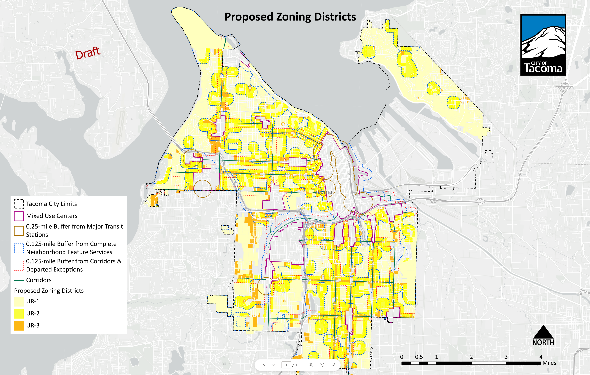
Proposed “Urban Residential” Zones
Follows Comp Plan, HIT 1 & HB 1110
Low-scale Residential = UR-1 or UR-2
Mid-scale Residential = UR-3
UR-2 in more walkable areas
1/8-mile of “complete neighborhood features”
1/4-mile of “major transit stations” (per HB 1110)
Of the area being rezoned…
UR-1: 61%
UR-2: 27%
UR-3: 12%
Notes:
Just show this with some explanation of how we got here- which they should already be caught up on

Slide 6
Housing Types
Houseplex
Backyard Building
Rowhouse
Courtyard Housing
Multiplex
A single building with up to 6 units (houses, duplexes, triplexes, fourplexes, fiveplexes and sixplexes), generally the size of a single-family house and includes an entry from the street and a backyard.
A building located behind another structure at the rear of a lot, which may contain a garage.
A multi-story building with access to the street from front door; it is always attached to 2 to 5 other Rowhouses, which together create a “Rowhouse Cluster”.
A group of detached or attached units arranged around a shared courtyard which is a shared social space which takes the place of private back yards.
A medium building consisting of 7 or more stacked units with the appearance of a large house or a small apartment building.
Notes:
Assuming different housing types can be combined on a site
Backyard Buildings – can be multiple units….

Slide 7
Draft zoning districts density & housing types
Urban Residential (UR-1) (Lowscale) | Urban Residential (UR-2) (Lowscale) | Urban Residential (UR-3) (Midscale)
DENSITY By right: 1/1500 sf (4 per lot) Density: 1/1000 sf (6 per lot) | By right: 1/1000 sf (6 per lot) Bonus: 1/750 sf (8 per lot) | By right: 1/750 sf (8 per lot) Bonus: 1/500 sf (12 per lot)
HOUSING TYPES Houseplexes Backyard Buildings Rowhouses Courtyard Housing (detached) | Houseplexes Backyard Buildings Rowhouses Courtyard Housing (all) | Houseplexes Backyard Buildings Rowhouses Courtyard Housing (all) Multiplexes
Reflects prior Council direction (supports middle housing, form-based approach, reflect neighborhood patterns, more housing near “complete neighborhoods”, gradual scale changes)
Brings HIT into full consistency with HB 1110 (4 dwellings per lot + 2 affordable, higher density near major transit)
Pre-existing lots smaller than 6,000 sf would also be allowed 4 dwellings + 2 affordable
Notes:
MAJOR POINTS TO CALL OUT?
Renamed zones
Renamed “houseplexes”
Still discussing what goes w zone vs housing type
Reflects state mandates
Refer to Development Standards Table
Bonus targeting still in the works

Slide 8
Topics
Confirm zoning framework
Building scale (setbacks & building separation, height, FAR): Do proposals strike the right balance between housing goals and reasonable compatibility with residential patterns?
Use of space
Bonus approach

Slide 9
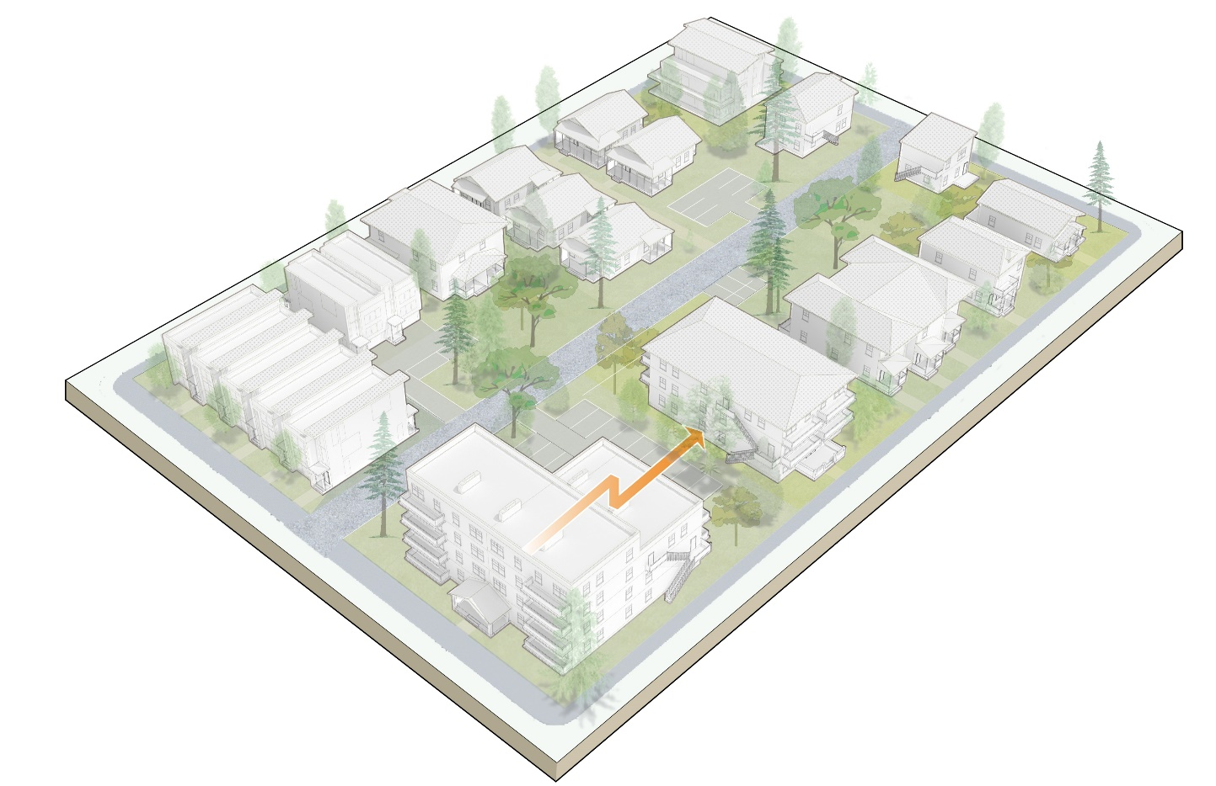
Housing development reasonably compatible with residential patterns
Rhythm along street
Building scale (height, size, width, depth)
Separation between buildings, front and rear yards
Pedestrian orientation, cars deemphasized
Retain existing structures
Retain existing (and add) trees
Notes:
Reference HIT1 policies
Round 2 engagement

Slide 10
Setbacks, Building Separation
BUILDING SEPARATION
6’ or 10’
Setbacks
Front: Reduce from 20 ft to 15 ft (10 ft in UR-3)
Rear: Reduce from 25 to 15 ft (10 ft in UR-3)
Side: Retain 5 ft, increase to 8 ft if used for unit access
Building Separation
New requirement: Minimum 6 ft, 10 ft for buildings 25 ft or taller
REAR
SETBACK
15’ / 10’
SIDE SETBACK
5’ or 8’
FRONT SETBACK
15’ / 10’
Creates space for housing infill, while still maintaining separation and space
Establishes rules for multiple buildings on a lot
Notes:
This approach makes room for infill while addressing issues raised by allowing multiple structures on a site.

Slide 11
Height
35’ MAX
25’ IN REAR YARD
Retain 35 ft limit for main buildings, 15 ft for accessory structures, no change to VSD height limits (25 or 20 ft)
Increase max height to 45 ft in UR-3 through bonus program
Consider reducing height to 25 ft for rear portion of lot (UR-1 and 2); increase to 35 ft through bonus program
45’ in UR-3
Generally, retains existing height limits, respects and neighborhood patterns
In limited cases, additional height used to promote bonus program
Notes:
Small lots change

Slide 12
Floor Area Ratio - Proposed
Urban Residential (UR-1) | Urban Residential (UR-2) | Urban Residential (UR-3)
EXISTING FAR 0.5 maximum FAR for small lots
PROPOSED FAR By right: FAR (1-2 units): 0.6 FAR (3+ units): 0.8 Bonus: 1.0 | By right: FAR (1-2 units): 0.8 FAR (3+ units): 1.0 Bonus: 1.2 | By right: FAR (1-2 units): 1.0 FAR (3+ units): 1.2 Bonus: 1.6
Strikes a balance with residential compatibility that favors significant housing development
Incentivizes more unit production by allowing more FAR for more units
Promotes use of bonus program by offering an FAR increase

Slide 13
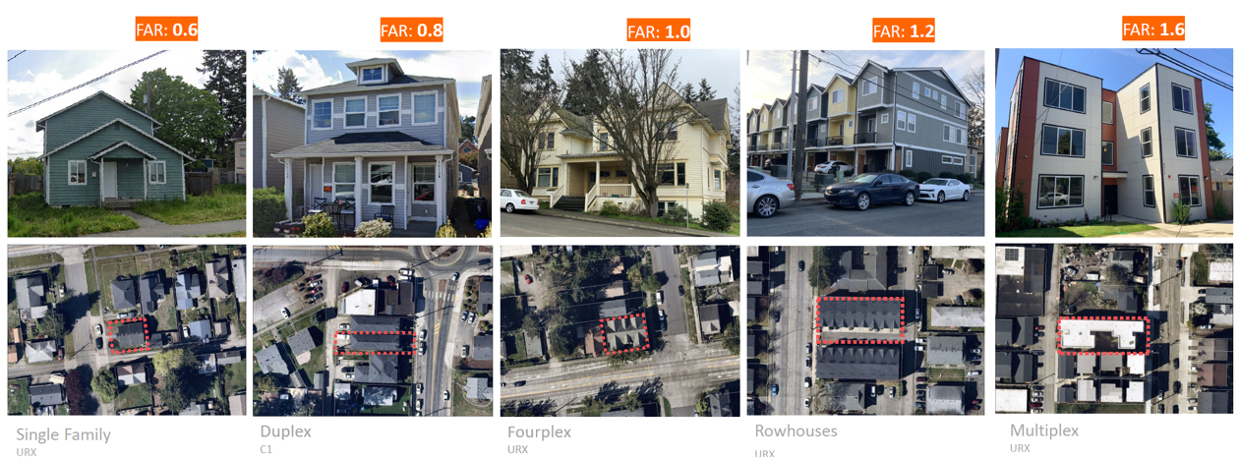
Floor Area Ratio - Examples
UR-1
UR-2
UR-3

Slide 14
Topics
Confirm zoning framework
Building scale
Use of space (parking, amenity space, trees): Does reducing parking and increasing tree requirements strike the right balance between housing and other goals?
Bonus approach

Slide 15
Parking
 | Current | Proposed
PARKING (CARS) | 2.0 stalls per single-family dwelling 1.25 per multifamily dwelling unit Some reductions available None required for ADUs | Parking tied to zone (not housing type) UR-1: 1.0 per unit UR-2: 0.75 per unit UR-3: 0.5 per unit Parking reduced through bonus program No parking required Reduced Parking Area (1/2-mile from major transit) For ADUs
DRIVEWAYS & PARKING STALLS | Driveways 10 ft wide, 20 ft for 2+ units Most stalls must be full size | Reduce required driveway widths Allow more/all stalls to be compact
Reduces parking requirements overall, implements state mandates (major transit stations, ADUs)
Reduces space dedicated to cars (driveways, parking stalls)
Promotes transportation choices (by tying parking to zoning districts)

Slide 16
Amenity Space
 | Current | Proposed
YARD/AMENITY SPACE | Single, duplex, triplex and small lots: 10% of lot size Multifamily: 20% of lot size Townhouses: 400 sf/unit private, and 100 sf/unit common space | Rename “amenity space” (consistent with Urban Design Studio) Tie to number of units (rather than lot size) Option 1 – by housing type 200 sf per unit for most housing types 100 sf per unit for multiplexes Option 2 – by zone UR-1: 300 sf per unit UR-2: 200 sf per unit UR-3: 100 sf per unit
Supports livability while leaving room for housing
Creates consistent calculation method for all housing types (square feet per unit)

Slide 17
Tree Credits - Concept
When 30% of the lot area is used to calculate tree requirements, what does this mean?
Not this:
But this:
30%
The percentage of lot area determines how many trees or "tree credits" are required on a site
Small, medium, and large trees are each worth a certain amount of credit toward this target area
However, these tree canopies can overlap with paving, buildings, and extend beyond the lot.
Structural soil cells can be used in constrained sites to provide soil for trees in the same place as driveways, parking, and paths.

Slide 18
Trees
Urban Residential (UR-1) | Urban Residential (UR-2) | Urban Residential (UR-3) (Midscale)
EXISTING TREE STANDARDS Single-family, duplex and triplex exempt from landscaping requirements, except street trees Multifamily must provide onsite canopy coverage, street trees
PROPOSED Street trees Onsite trees (retention and planting): Equivalent to 35% lot coverage | Street trees Onsite trees (retention and planting): Equivalent to 30% lot coverage | Street trees Onsite trees (retention and planting): Equivalent to 25% lot coverage
Aims to support Tacoma’s 30% tree canopy goal in balance with housing development
Reduces tree requirements in denser zones
Simplify and add flexibility to the landscaping code

Slide 19
Topics
Confirm zoning framework
Building scale
Use of space
Bonus approach (bonuses on offer, public benefits): What public benefits should be promoted through the bonus program?

Slide 20
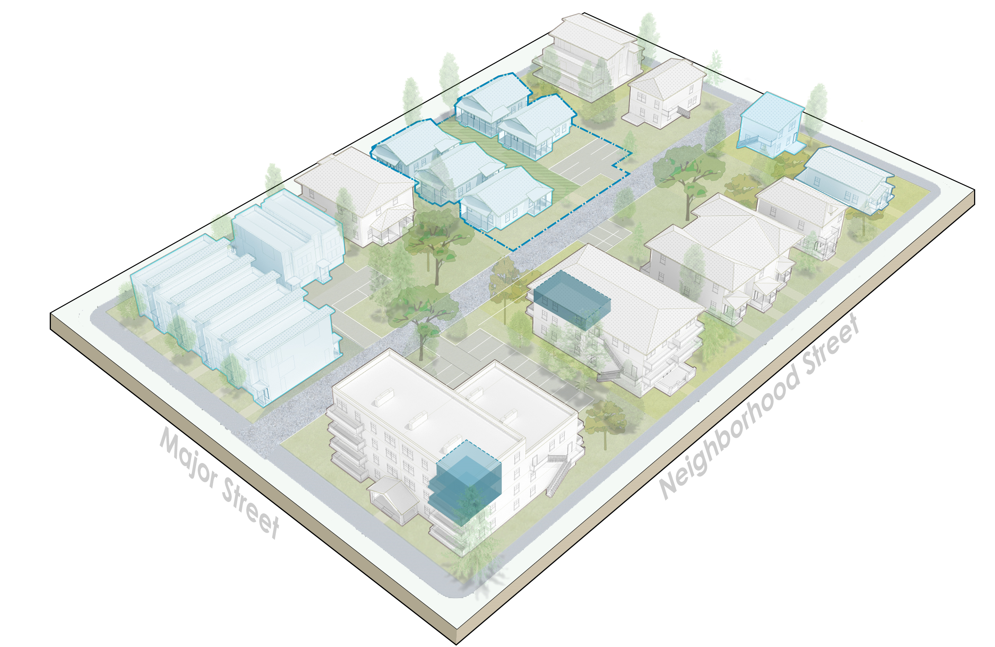
Affordability and bonusing
Adopted policy direction
Calibrate standards to promote affordability
Strengthen regulatory affordable tools
Expand Multifamily Tax Exemption Program
Coordinated anti-displacement strategy
Key Decisions
Understanding the market – promote affordability without slowing construction
Setting priorities – location, households served, duration of affordable units
What incentives and bonuses make sense
Notes:
Phase 1 direction
How we write housing rules matters for how much housing gets built and affordability
Middle housing is important – but there will remain unmet need for affordable housing
Ownership opportunities
Decisions:
Over next couple of months – gathering input on tradeoffs (both for standards AND for specific affordability tools); using that to come up with big moves
One basic concept – incentives need to be valuable to developers (often that means allowing bigger buildings/more units)
By March-April:
At neighborhood meetings, share how those could play out
Refinements to the proposals

Slide 21
Bonuses program - introduction
Bonuses | Public benefits
More units (density) Larger buildings (FAR) Taller buildings (rear yard, UR-3) Parking reductions Multifamily Tax Exemption Program (in some zones) | Affordable housing units POTENTIAL Retain existing buildings with infill (supports multiple goals) Sustainability (other actions supporting) Visitability (other actions supporting) Family-sized units (middle housing itself promotes range of unit sizes)
Bonuses have significant value, striking a balance with residential compatibility
Public benefits compete with each other – supports keeping the list short
Next steps include market feasibility study, affordability targeting (number, levels, duration), stakeholder consultation, MFTE expansion

Slide 22
Discussion
Zoning framework (map, housing types, densities): Seeking confirmation that the draft framework reflects City Council guidance to date.
Building scale (height, Floor Area Ratio, setbacks): Do proposed building scale controls strike the right balance between housing goals and reasonable compatibility with residential patterns?
Use of space (parking, landscaping, amenity space): Does reducing parking and increasing tree requirements strike the right balance between housing and other goals?
General bonus approach (bonuses on offer, public benefits): What public benefits should be promoted through the bonus program?
OTHER DIRECTION?

Slide 23
Revised project schedule
July to Dec 2023
Jan to March 2024
May to July 2024
Develop full package
EIS Consultation
Planning Commission Public Hearing
Release Draft EIS
Planning Commission recommendation
City Council review
Release Final EIS
Council Public Hearing
Council action
INPUTS
Round 1 engagement
2023 legislative direction
Round 2 engagement
Ongoing engagement throughout

Slide 24
Home In Tacoma Project
City Council Study Session
September 26, 2023

